Slide 1

PCWG 2015 Roadmap – A3 Report Introduction
PCWG
9th Meeting: 12 December 2014 - Glasgow

Slide 2
Brief Introduction to A3 Report Format
The PCWG 2015 Road Map will use the A3 Report Format.
Background
(Reasons for Action)
Insights/Observations
(Anything else we should keep in mind)
Current Industry State
(Where we are now)
Gap
Target Industry State
(Where we need to be)
Reasons for gap between current and target
PCWG 2015 Actions

Slide 3
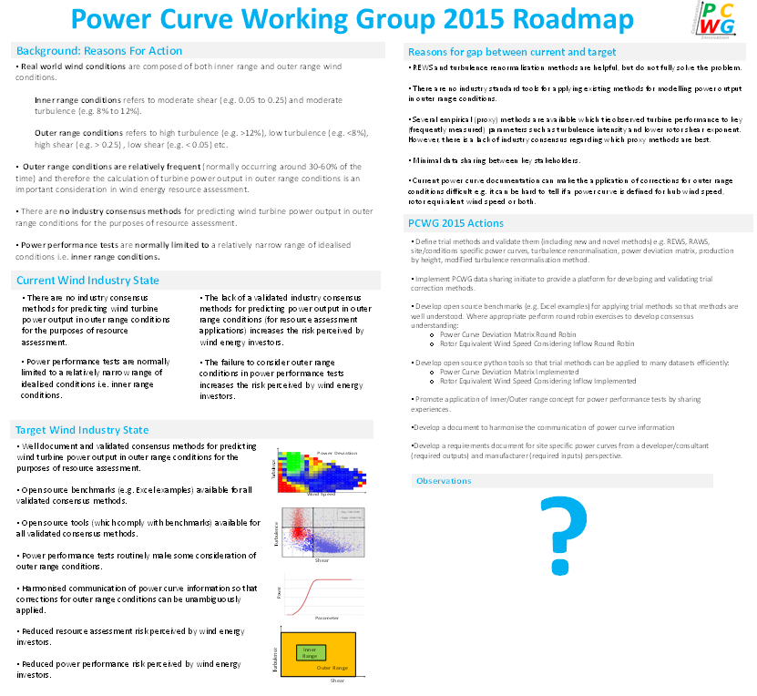
A3 Report Format
A3 Report Format: Statement of problem and solution designed to fit on a single A3 page.
Report divided into 6 boxes*:
Reasons for action
Current State
Target State
Gap Analysis
Action Plan
Insights and Observations
* Variants of the A3 report with up to 9 boxes exist, but the PCWG is working with a relatively simple form of the A3 report.
A3 thinking was pioneered by Toyota see: http://www.amazon.co.uk/Understanding-A3-Thinking-Component-Management/dp/1563273608

